Slide 1
PRISM
Daniel Hellfeld

Slide 2
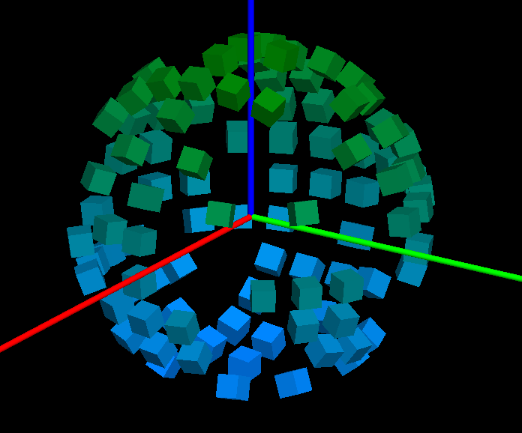
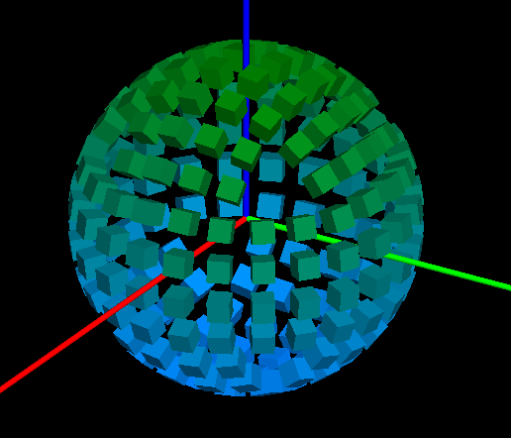
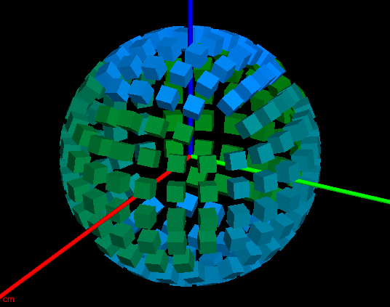
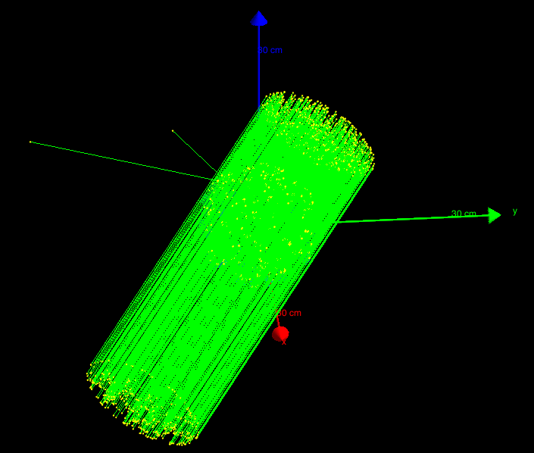
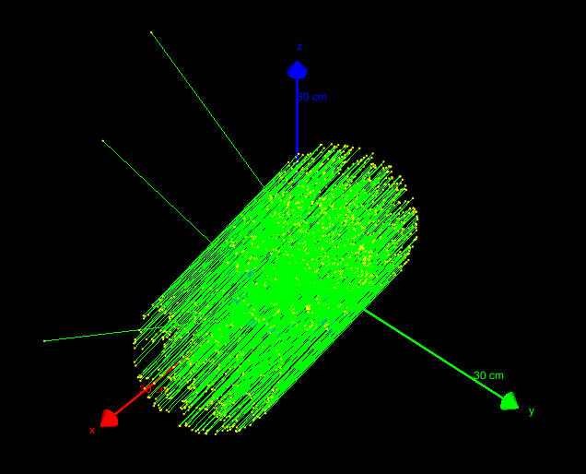
Geant4 simulation – PRISM_SIM
(https://github.com/dhellfeld/CAI_Toy_Imager)
Random mask – ringed detectors
Fully populated – ringed detectors
Fully populated – nested detectors
Running particles

Slide 3
# Run.mac
# Tracking secondary electrons
#/PRISM_SIM/tracking/trackElectrons Off
# Detector indexing
/PRISM_SIM/geom/detIndexing Ring
# Configure mask
#/PRISM_SIM/geom/setMask 21524FA478BD521AB44791322B545C979943A029753854BB
#/PRISM_SIM/geom/randomMask
/PRISM_SIM/geom/fullMask
# Change the energy
/gun/energy 60 keV
# Set the direction of far field source
#/PRISM_SIM/direction/setTheta 45
#/PRISM_SIM/direction/setPhi 20
# Configure HEALPix
/PRISM_SIM/direction/setHPNside 8
/PRISM_SIM/direction/setHPindexscheme Ring
/PRISM_SIM/direction/SetUpHEALPix
# Choose a HealPix angle (start at 1)
/PRISM_SIM/direction/setHPindex 45
# Change output file name
/PRISM_SIM/output/filename output1
#Print to text or binary format
/PRISM_SIM/output/printText Off
/PRISM_SIM/output/printBinary On
# Beam on
/run/beamOn 100
# Response.mac
#/control/loop macros/response/healpix/main.mac hpindex 1 768 1.
/control/loop macros/response/healpix/main.mac hpindex 1 3072 1.
# Main.mac
# Pick healpix angle
/PRISM_SIM/direction/setHPindex {hpindex}

Slide 4
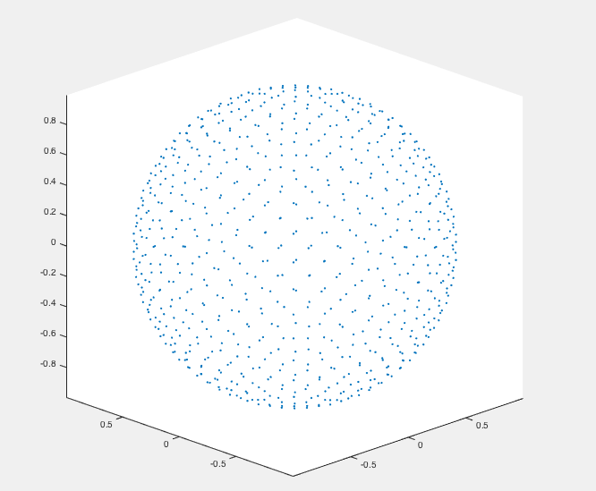
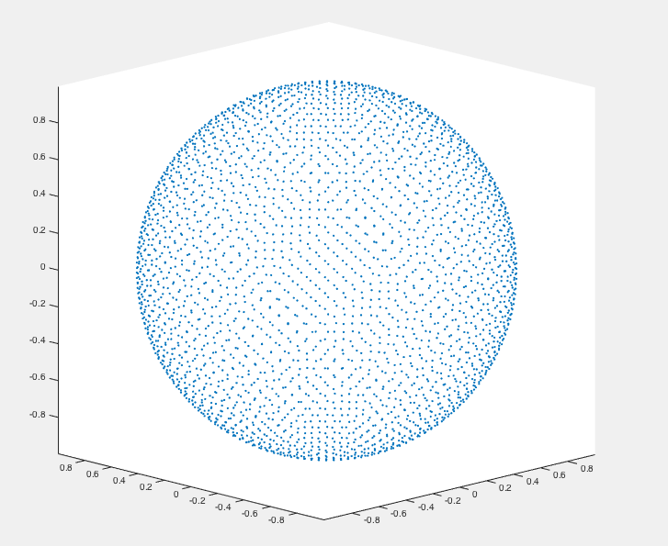
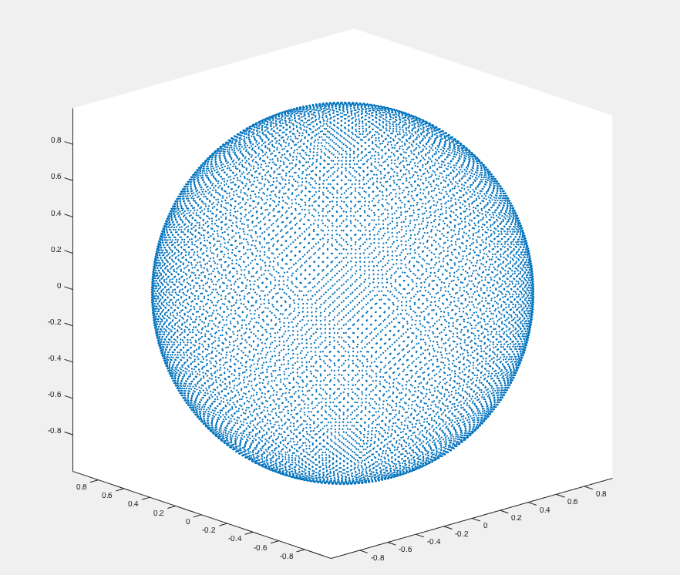
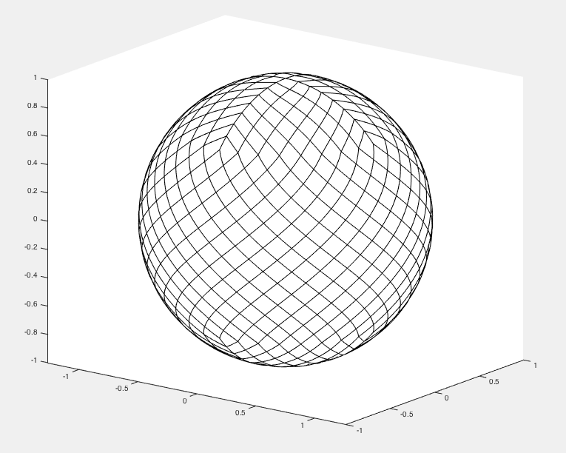
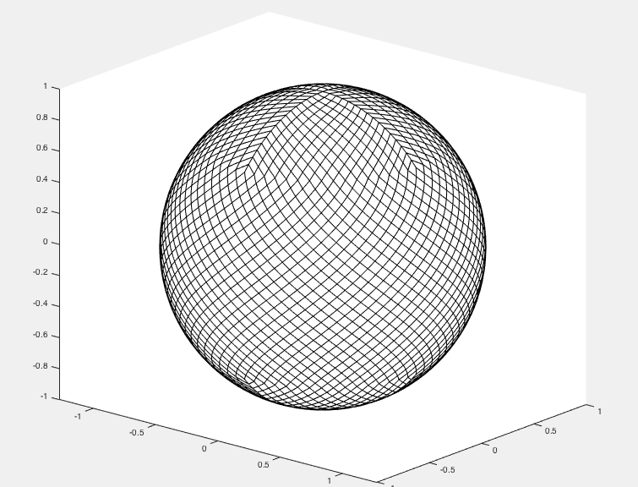
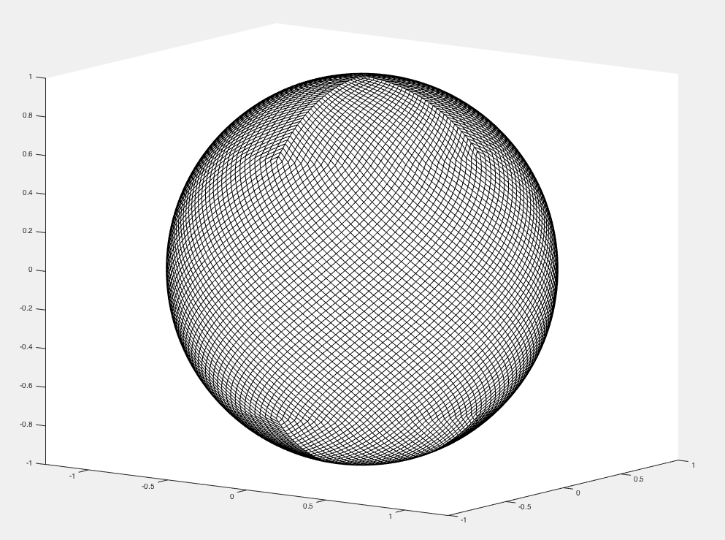
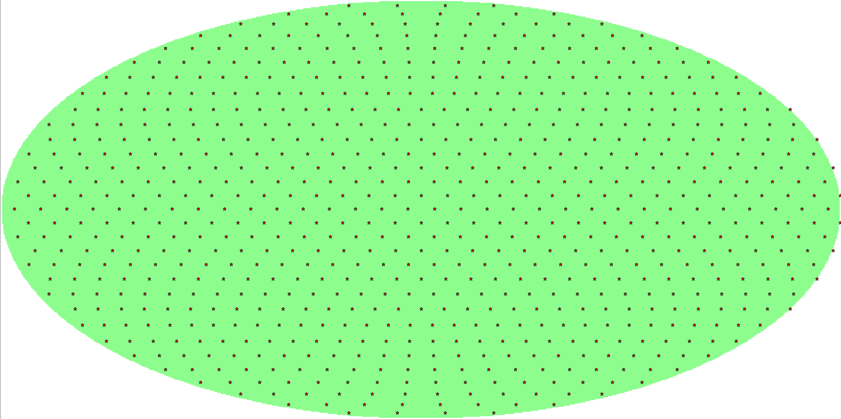
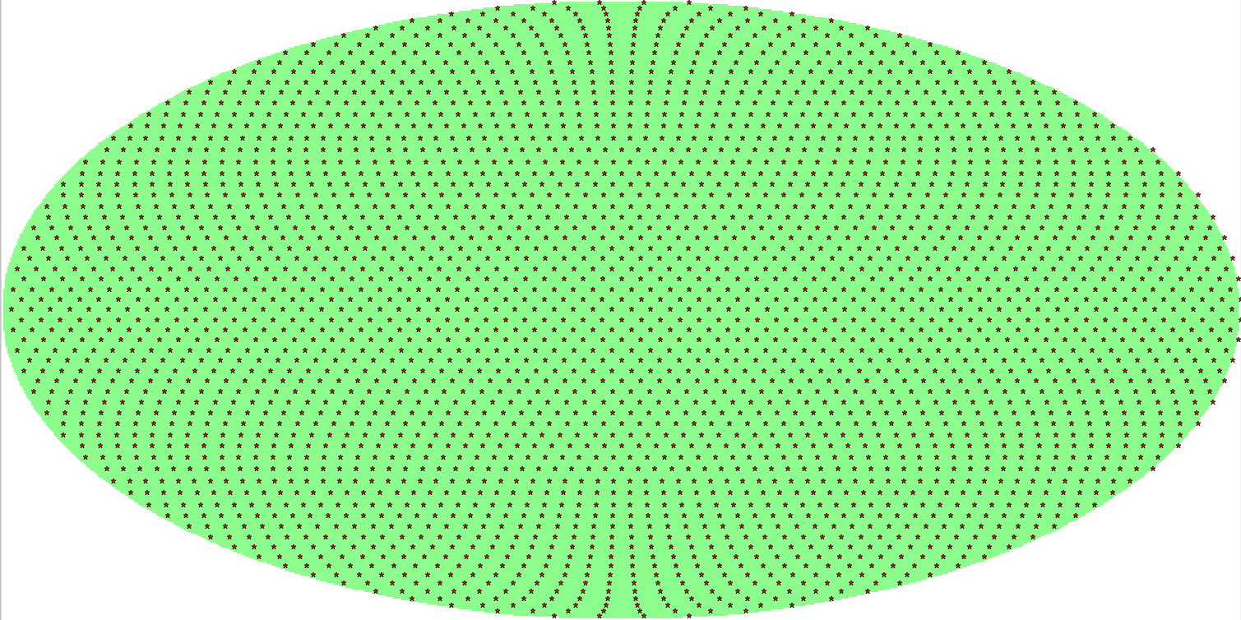
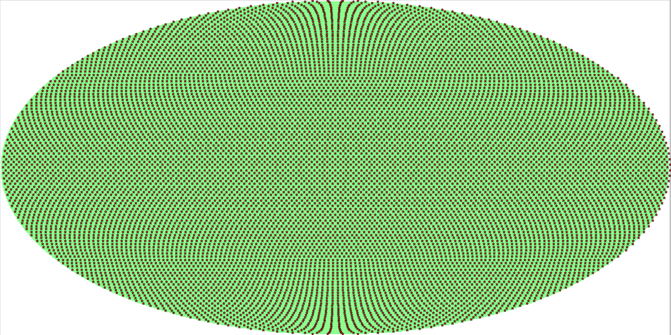
HEALPix – Hierarchical Equal Area isoLatitude Pixelization of a sphere
(Nested or ring … everything done in ring indexing)
Matlab (http://homepage2.nifty.com/plasma/program/healpix.html)
Nside = 8 (768 pixels)
Nside = 16 (3072 pixels)
Nside = 32 (12288 pixels)
Resolution = 7.3 deg
Resolution = 3.7 deg
Resolution = 1.8 deg
Python (healpy) (http://healpy.readthedocs.io/en/latest/index.html)
Nside = 8 (768 pixels)
Nside = 16 (3072 pixels)
Nside = 32 (12288 pixels)

Slide 5
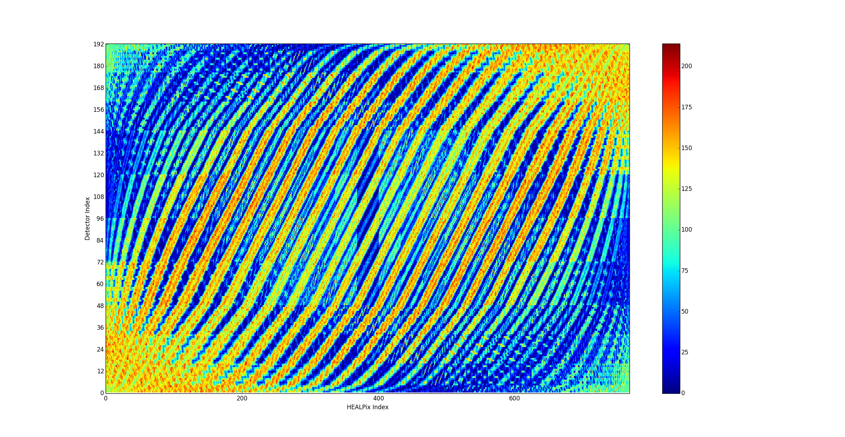
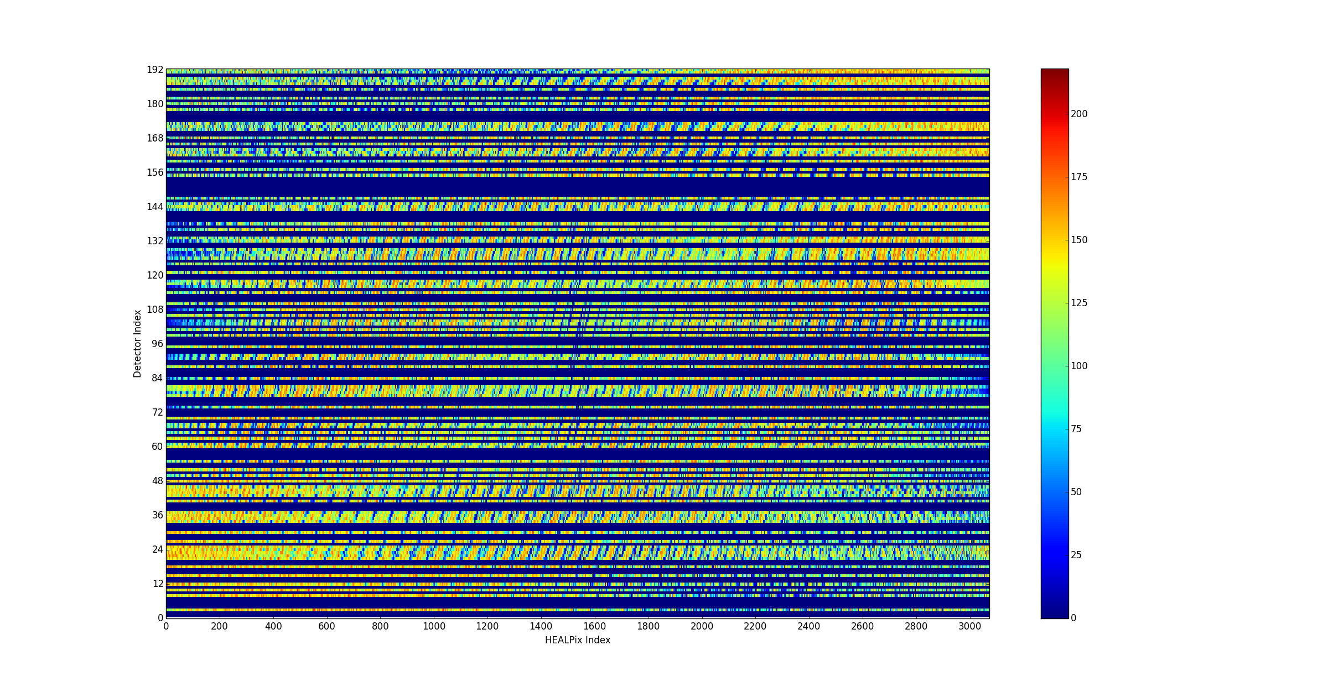
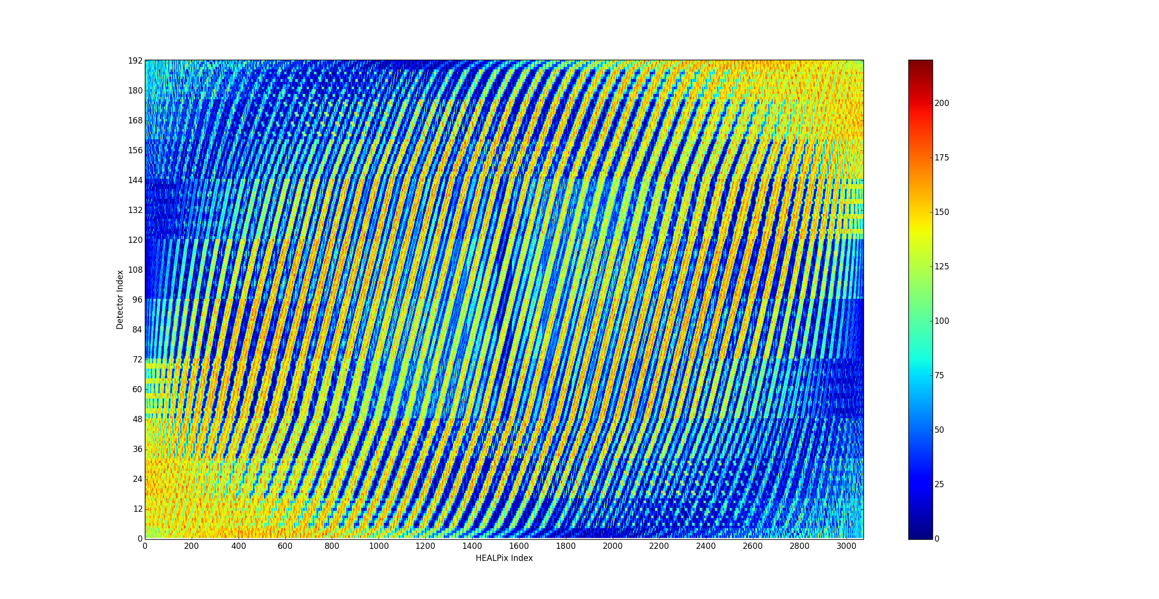
HP ringed, Nside = 8, Ringed detectors, 20k particles, mask = full
HP ringed, Nside = 16, Ringed detectors, 20k particles, mask = 2151…
HP ringed, Nside = 16, Ringed detectors, 20k particles, mask = full

Slide 6
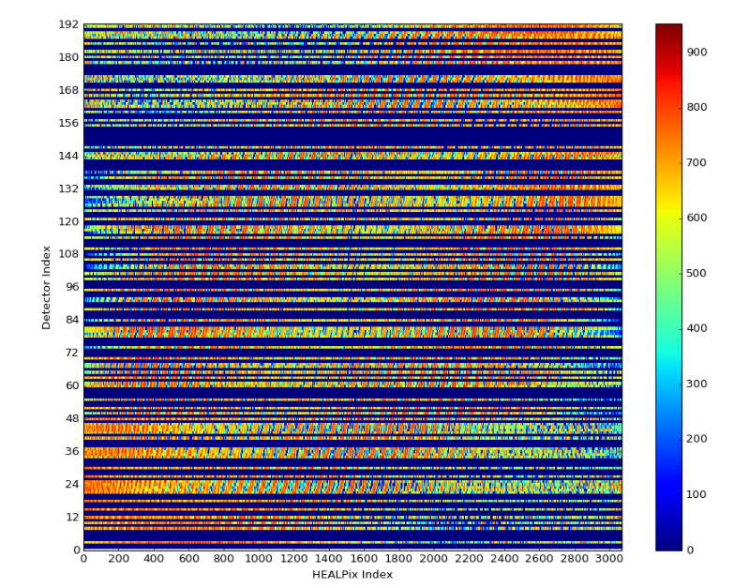
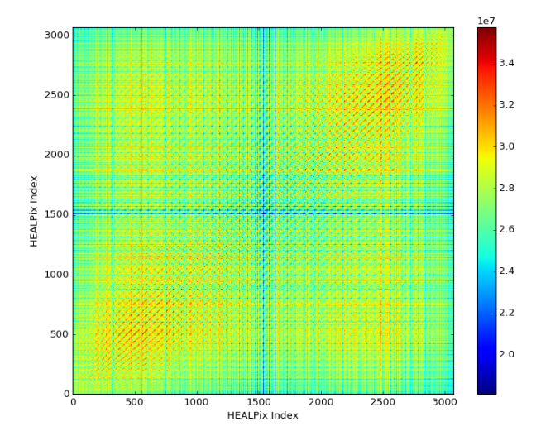
System response = S
S^{T}S (~autocorrelation)
Detector ID vs. Incident HP index
HP ringed, Nside = 16, Ringed detectors
100k particles, mask = 2152…

Slide 7
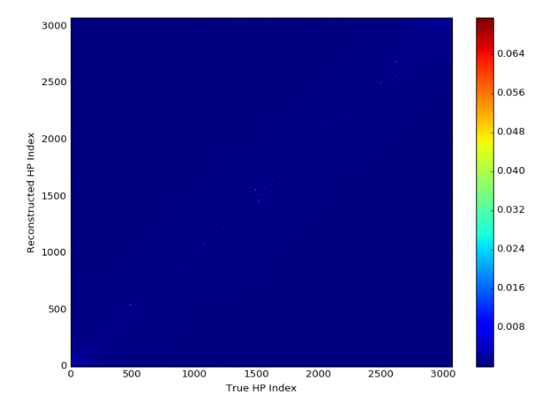
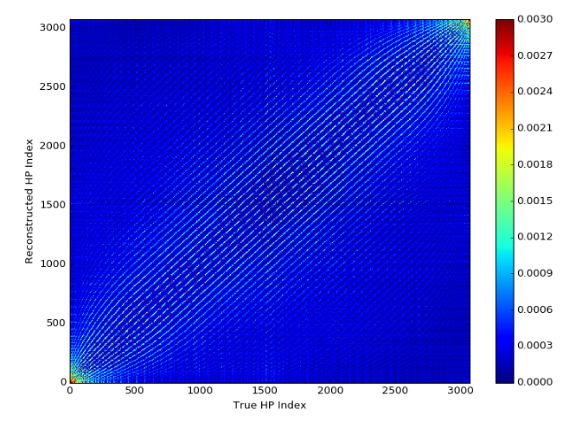
MLEM reconstruction at every source angle
Bring down color map

Slide 8
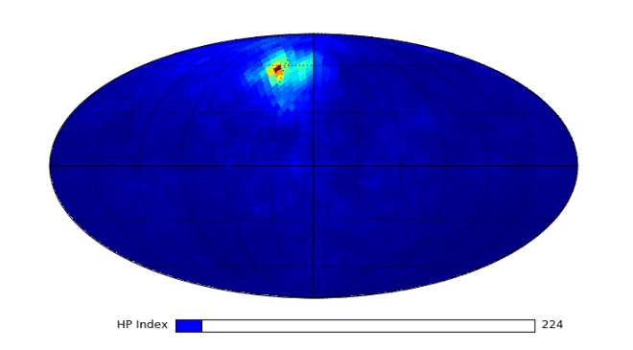
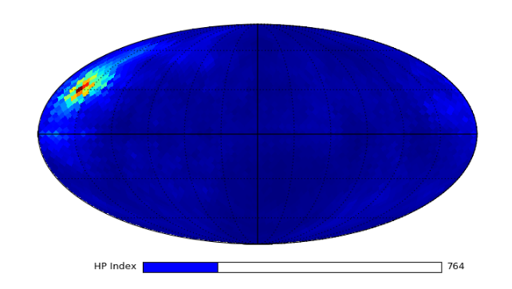
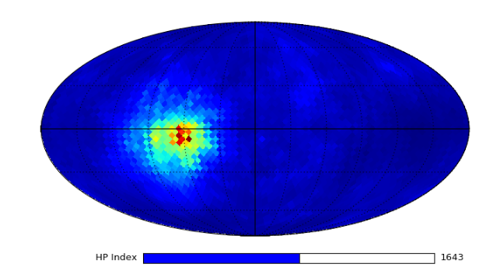
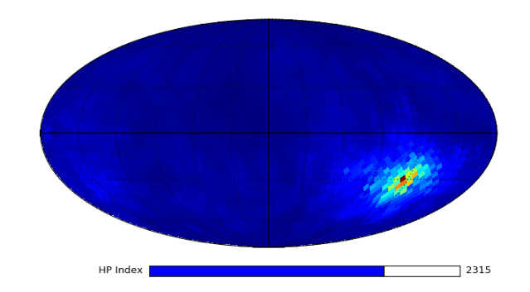
MLEM reconstruction on 4pi sphere with interactive slider

Slide 9
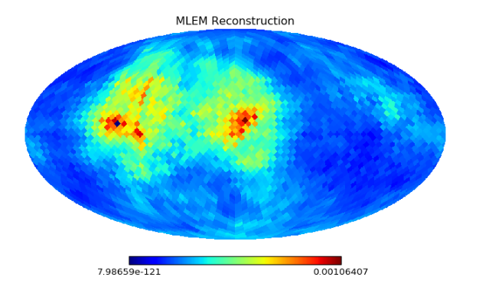
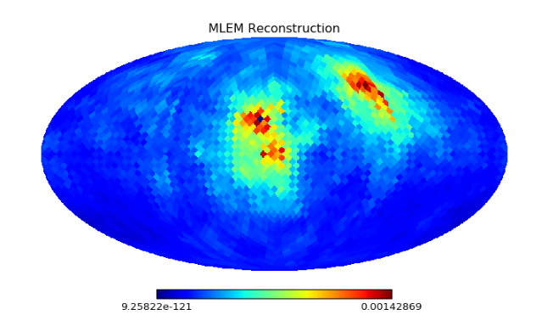
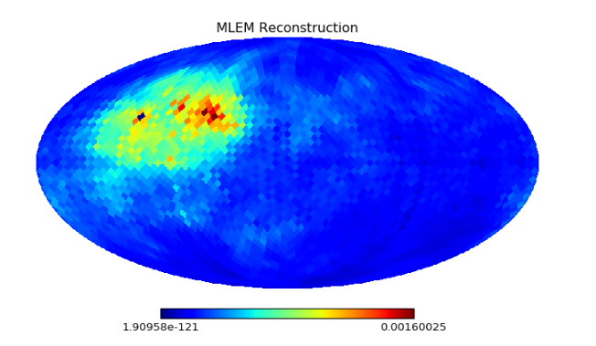
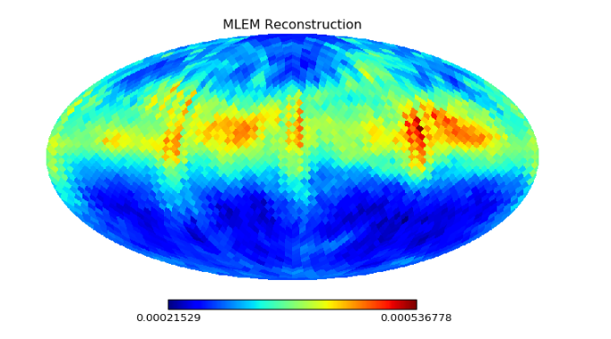
Two sources, ring source
(now put a white cross on true location…)
HP = 1330, 1310
HP = 930, 530
HP = 820, 810
HP = 1248:1312 (ring)

Slide 10
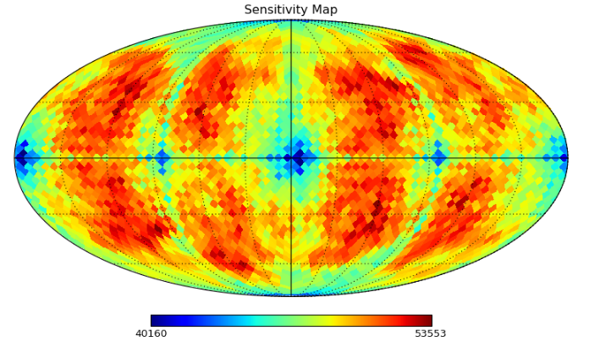
Notice scale…

Slide 11
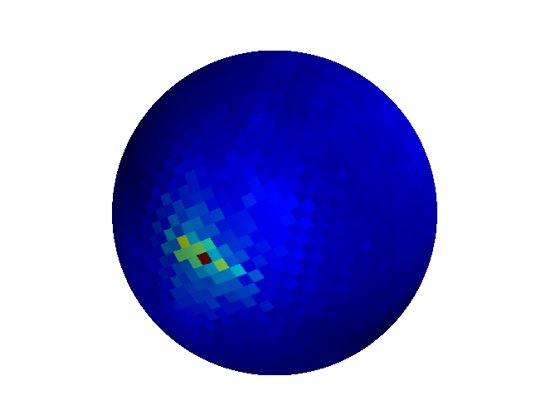
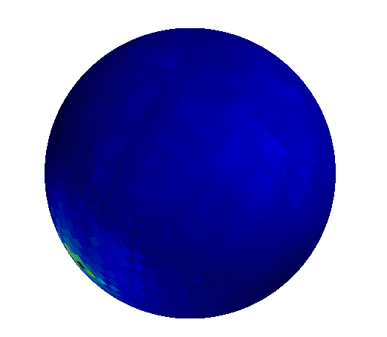
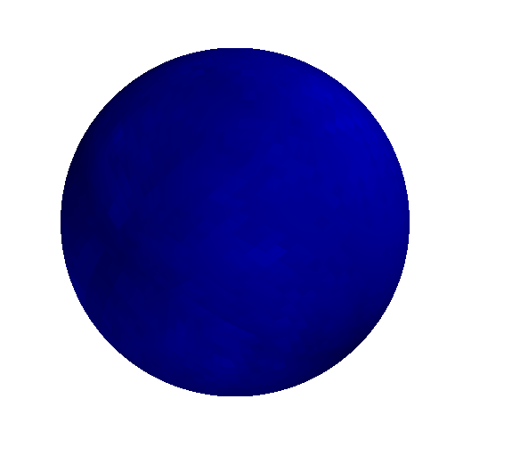
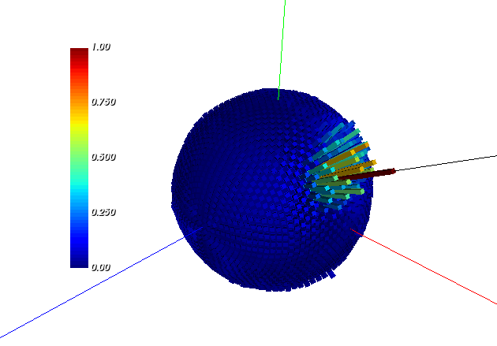
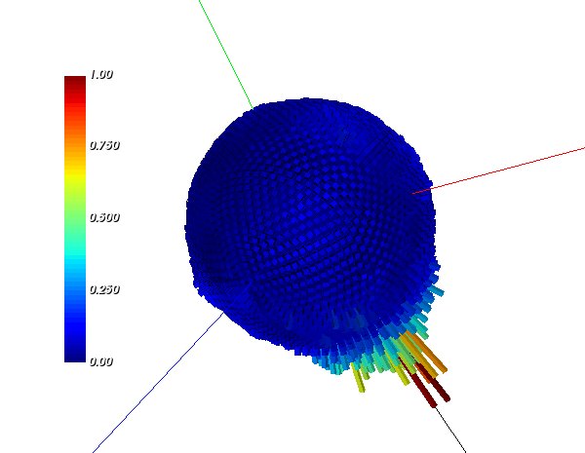
MLEM reconstructed image on 3D sphere (mayavi python)
(heat map)
Spherical histograms (VTK python)
- As opposed to heat map

Slide 12
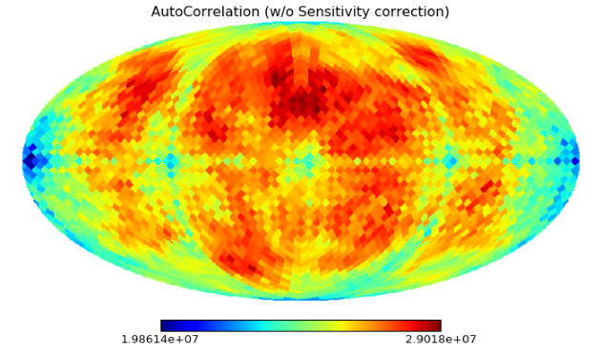
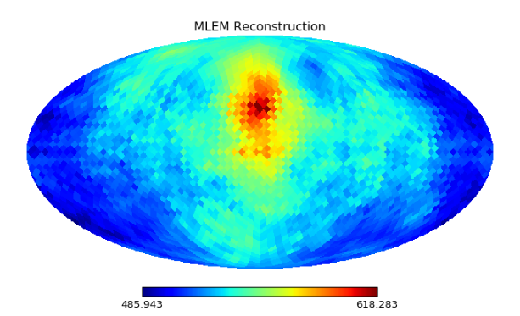
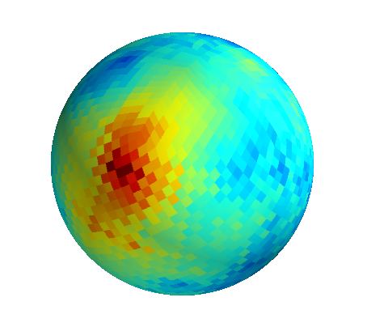
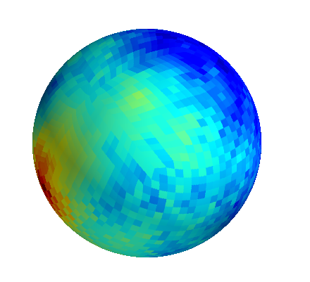
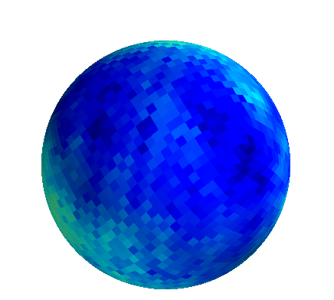
Autocorrelation image, not corrected for sensitivity map
HP index = 800
Row of autocorrelation, corrected for sensitivity map

Slide 13
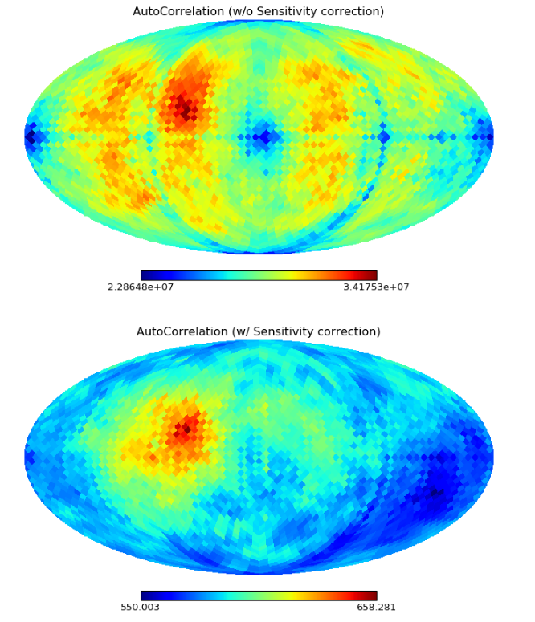
HP index = 1066

